Slide 1

Big Mart Sales Big Mart Sales Prediction
Done By
Boorla Sai Teja
12014428

Slide 2
What is good about Big Mart
Long history : Big Mart has been doing a wholesale business at LA for more than 20 years. Our goal is to prosper with our customers.
Big Save : Big Mart is a one stop shopping center. We have Los Angeles downtown store and online marketplace. We focus on wholesale for retailers or school fund raisers or party organizers.
We also help online sellers buy merchandise at cheapest price.
Easy to set up your store : Set up a new store in our Shopping Mall .
Low-Cost AD : Advertise your goods or website at low cost
2 Big size Ads( Big size slide head banner and Big size nonmoving banner ) only a dollar a day
​Visit low-cost AD page.
You can sell without fee :Why pay so much selling fee? Advertising fee is free as long as you buy from Big Mart wholesale network (Visit Free AD page)
​Easy Access : Easy access to BigMart.com through
​Google, Bing, Yelp, Yahoo, Facebook.

Slide 3
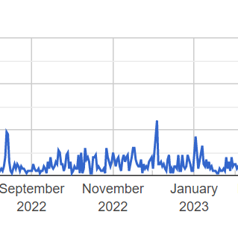
About Big Mart Sales Dataset
The data scientists at Big Mart have collected 2013 sales data for 1559 products across 10 stores in different cities. Also, certain attributes of each product and store have been defined. The aim is to build a predictive model and predict the sales of each product at a particular outlet.
Using this model, Big Mart will try to understand the properties of products and outlets which play a key role in increasing sales.
The dataset provides the product details and the outlet information of the products purchased with their sales value split into a train set (8523) and a test (5681) set. Train file: CSV containing the item outlet information with sales value Test file: CSV containing item outlet combinations for which sales need to be forecasted.
Sales of a given product at a retail store can depend both on store attributes as well as product attributes. The dataset is ideal to explore and build a data science model to predict the future sales.
Some of Columns present inside the dataset are mentioned below:
Product ID, Weight, Fat content, Visibility, Product type, MRP, OrderID

Slide 4
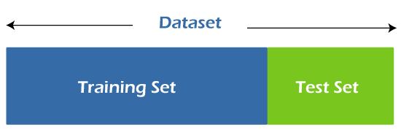
Testing and Training
Splitting the dataset into train and test sets is one of the important parts of data pre-processing, as by doing so, we can improve the performance of our model and hence give better predictability.
Training the Data
The training data is the biggest (in -size) subset of the original dataset, which is used to train or fit the machine learning model.
The testing data should:
Represent or part of the original dataset.
It should be large enough to give meaningful predictions.
Testing the data
Once we train the model with the training dataset. This dataset evaluates the performance of the model and ensures that the model can generalize well with the new or unseen dataset. The test dataset is another subset of original data, which is independent of the training dataset.

Slide 5

R Squared value
R-squared is a statistical method that determines the goodness of fit.
It measures the strength of the relationship between the dependent and independent variables on a scale of 0-100%.
The high value of R-square determines the less difference between the predicted values and actual values and hence represents a good model.
It is also called a coefficient of determination, or coefficient of multiple determination for multiple regression.

Slide 6
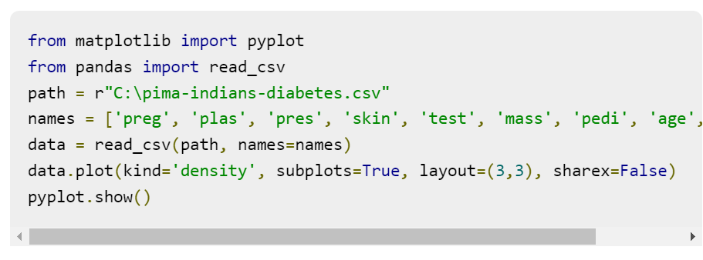
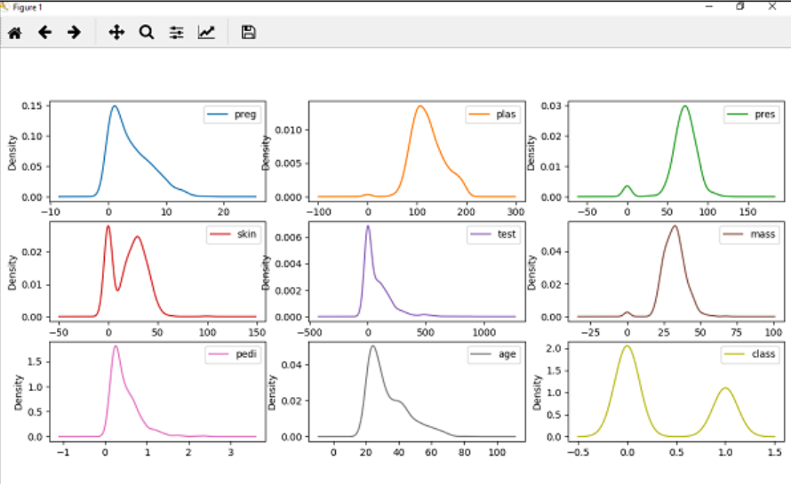
Density Plot
Density plots one of the quick and easy technique for getting each attributes distribution is Density plots. It is also like histogram but having a smooth curve drawn through the top of each bin. We can call them as abstracted histograms.

Slide 7
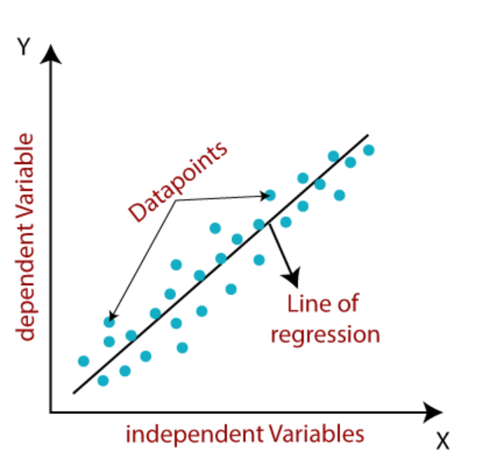
Linear Regression
Linear regression is one of the easiest and most popular Machine Learning algorithms. It is a statistical method that is used for predictive analysis. Linear regression makes predictions for continuous/real or numeric variables such as sales, salary, age, product price, etc.
Linear regression algorithm shows a linear relationship between a dependent (y) and one or more independent (y) variables, hence called as linear regression.

Slide 8


